Slide 1
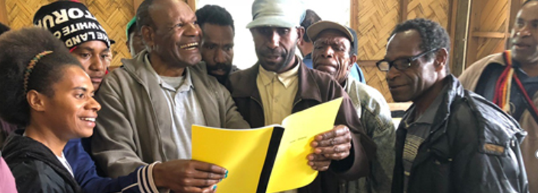
On the first day of the seventh month, Ezra the priest brought the law before the assembly, both men and women, and all who could hear and understand…Ezra opened the book in the sight of all the people, for he was standing above the people, and when he opened it all the people stood up. Ezra blessed Yahweh, the great God, and all the people lifted up their hands and answered, "Amen! Amen!" Then they bowed down and worshiped Yahweh with their faces to the ground (Neh. 8:2, 5-6).
All Scripture taken from the English Unlocked Literal Bible (ULB), ©2017, 2022 Wycliffe Associates, Available at https://bibleineverylanguage.org/translations, licensed under the Creative Commons Attribution-ShareAlike 4.0 International License.
The English ULB is based on the unfoldingWord® Literal Text, CC BY-SA 4.0. The original work of the unfoldingWord® Literal Text is available at https://unfoldingword.bible/ult/.
Community Acceptance

Slide 2
1 Corinthians 9:22
To the weak I became weak, so that I may win the weak. I have become all things to all people, so that I may by all means save some.

Slide 3
?

Slide 4
Luke 14:28-29
For which of you who desires to build a tower does not first sit down and count the cost to calculate if he has what he needs to complete it? Otherwise, when he has laid a foundation and is not able to finish, all who see it will begin to mock him,

